Slide 1


Jain College of Engineering & Research,
Udyambag, Belagavi
NBA Accredited Programs: ECE & MECH Department of Applied Science
A Final Presentation on
“AETHER LINK ”
Team No.:15
Guide: Rajani Ma’am
Team Associates:
Huriyabanu G (2JR25EC027) BiBifatima C (2JR25EC018)
SpandanaLBhavi (2JR25EC069)
Kritika S Kharge (2JR25EC032)
Yashmita H (2JR25EC090)
Course: Interdisciplinary Project Work (1BPRJ258)

Slide 2
Introduction to Problem Area
Brief background of chosen domain
Aether Link is a wireless communication system developed using LoRa and ESP32 technology. It is designed to send emergency messages over long distances without internet connectivity. The project focuses on reliable, low-power, and fast communication during critical situations.
Why your team chose this topic
Our team selected this project to create a useful solution for emergency communication. It helped us gain practical knowledge in IoT, embedded systems, and wireless networking. The idea is simple, innovative, and suitable for real-world applications.
Relevance to social or community needs
Aether Link can help people send emergency alerts quickly during accidents or disasters. It is especially useful in remote areas where mobile networks are unavailable. The project improves communication safety and supports faster emergency response.

Slide 3
Literature Survey
Sl no. | Paper/Article title | Publication details | Result
1 | LoRa Based Emergency System | IEEE Journal, 2023 | Achieved long-range communication
2 | Wireless Alert Communication | International Conference, 2022 | Improved emergency response
3 | IoT Safety Communication Device | Research Paper, 2024 | Reliable low-power message transfer

Slide 4
Problem Statement
Lack of communication in remote areas during emergencies can delay help and rescue operations.
Mobile networks and internet services may fail during natural disasters or accidents.
Existing emergency communication systems are expensive and not easily accessible to everyone.
There is a need for a low-cost, reliable, and long-range wireless alert system like Aether Link.

Slide 5
Objectives
Design and development of a reliable long-range wireless communication system using LoRa technology.
Quick transmission of predefined emergency messages during critical situations.
Communication support for remote areas where internet and mobile networks are unavailable.
Development of a low-cost, low-power, and portable emergency communication device using ESP32 modules.
Improvement of public safety through faster emergency response and alert notification.

Slide 6
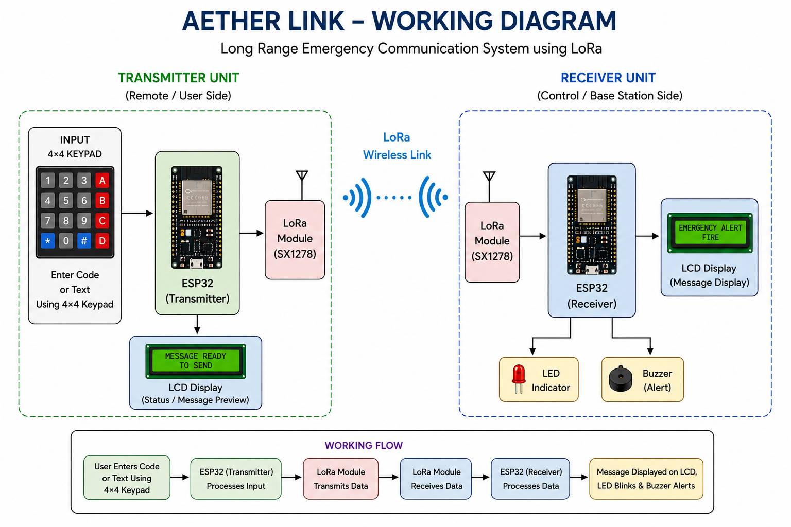
Workflow Diagram / Working Principle

Slide 7
Prototype Development
Selection of ESP32, LoRa module, 4×4 keypad, LCD display, buzzer, and LED components for system development.
Design and assembly of transmitter and receiver units using proper circuit connections and power supply.
Programming of ESP32 modules for message transmission and reception through LoRa communication.
Integration of keypad input, LCD message display, and alert indications for emergency notification.
Testing and debugging of wireless communication range, message accuracy, and system performance.

Slide 8
Results
Successful transmission and reception of emergency messages using LoRa wireless communication.
Reliable long-range communication achieved without the use of internet or mobile networks.
Proper display of received messages on the LCD screen with LED and buzzer alert indications.
Smooth functioning of keypad-based message selection and transmission using ESP32 modules.

Slide 9
Conclusion
Aether Link successfully provides long-range wireless emergency communication using LoRa technology.
The system enables quick transmission of emergency messages without internet or mobile network support.
Integration of ESP32, keypad, LCD, LED, and buzzer ensured reliable and effective system performance.
The prototype proved to be low-cost, portable, and suitable for real-time emergency situations.

Slide 10
References
IEEE Papers on LoRa Communication.
ESP32 Technical Manual.
Arduino IDE Documentation.
IoT Emergency Alert System Journal.
Wireless Communication Research Papers.

